Slide 1

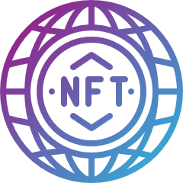
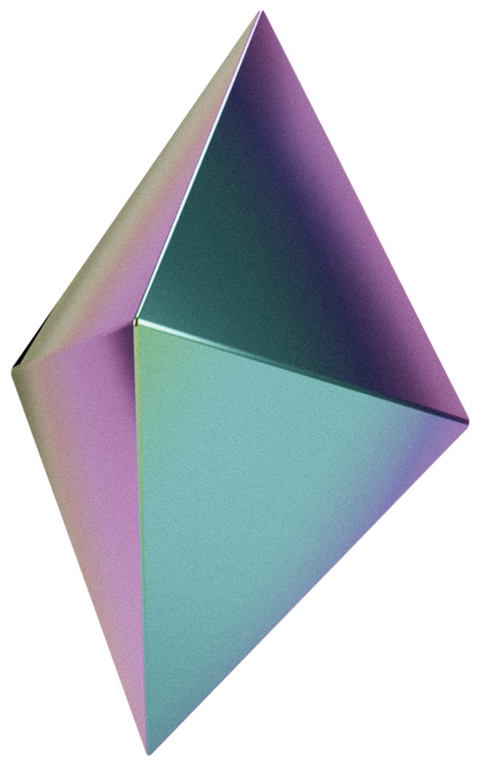
NFT MARKETPLACE
PRESENTATION
Presented by:
Mohd Mamoon and Ilma Shah
Supervisor: Prof. M. Sarosh Umar

Slide 2

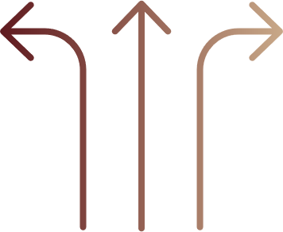
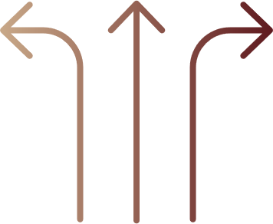
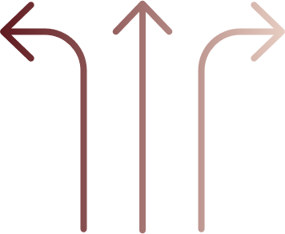
OUTLINE
LITERATURE REVIEW
INTRODUCTION
SYSTEM IMPLEMENTATION
CONCLUSION

Slide 3
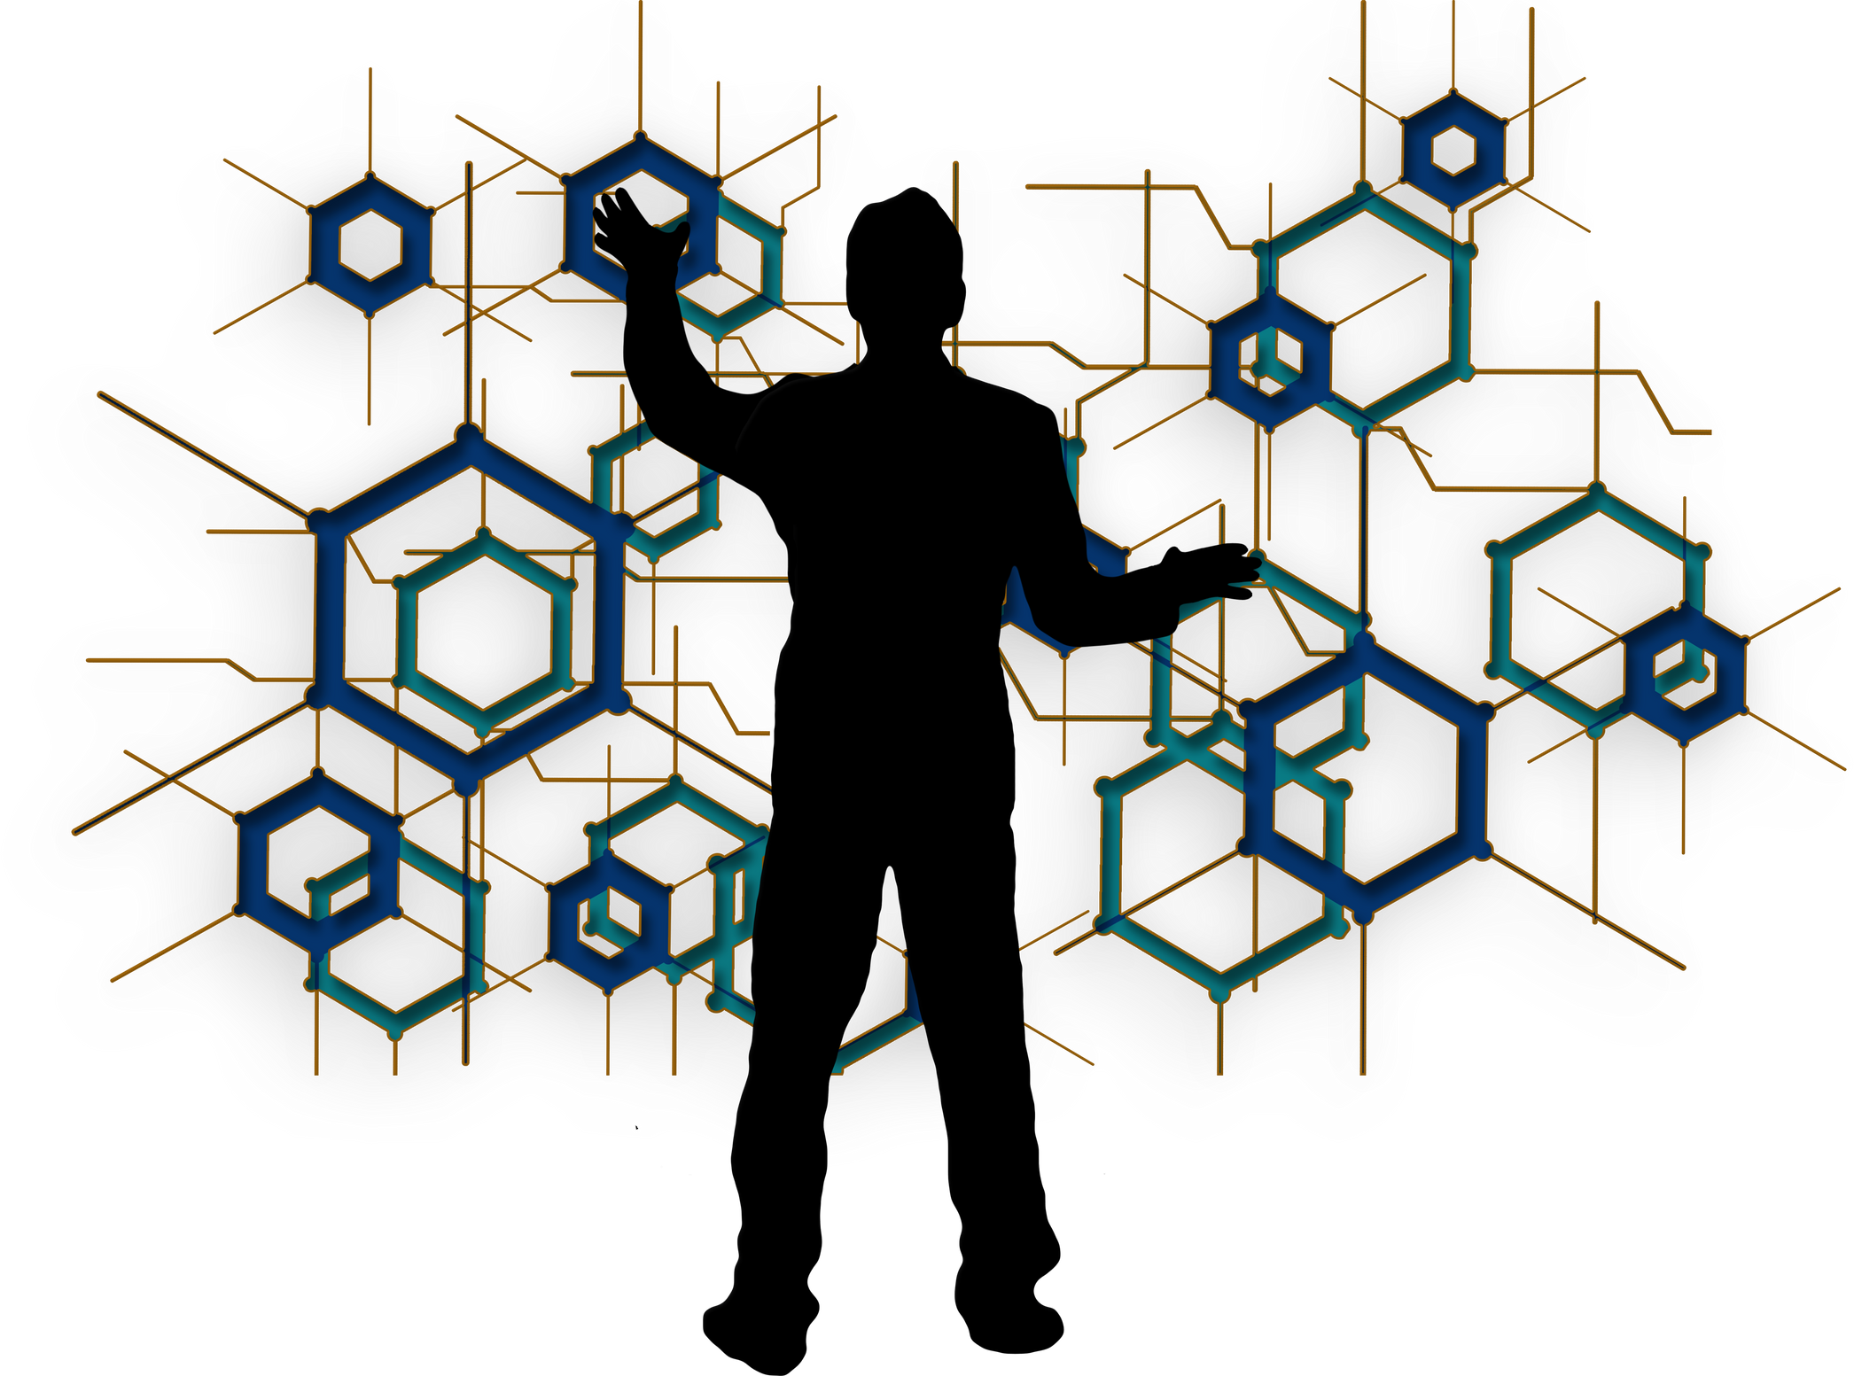
1 . INTRODUCTION

Slide 4
1.1 BACKGROUND
The value of art is defined by two key factors: the creative performance and the degree of physical contact with the original artist.
The value of an artwork deteriorates if identified as a forgery and if the creative act is deemed unsatisfactory.

Slide 5
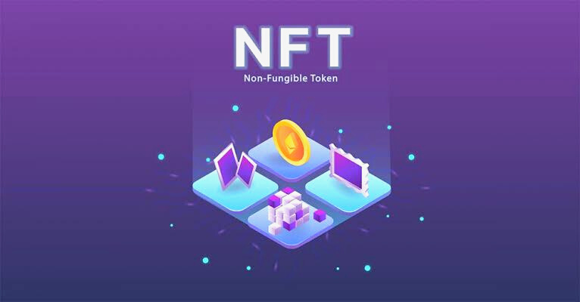
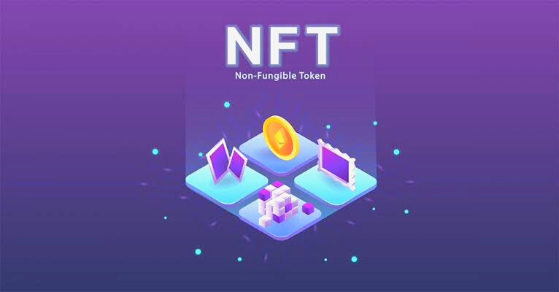
1.2 PROBLEM STATEMENT
The forgery of high-end art has become more common.
As a consequence, the authentication of art is an important factor during valuation.

Slide 6
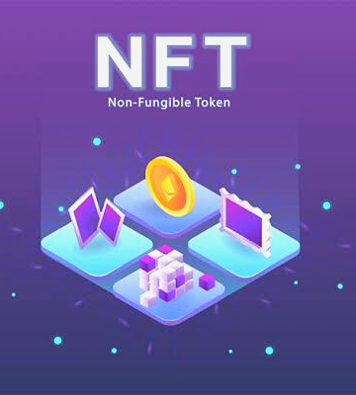
1.3 PROPOSED SOLUTION
The sale and movement of NFTs can be traced, verified and recorded on an immutable ledger.
This means that their creation, unique identifiers, and ownership is not only traceable, but also verifiable.

Slide 7
1.4 FUNCTIONAL DEPENDENCIES
FRONT-END
BACK-END
TOOLS
HTML5
CSS
JavaScript
React
NodeJS
Solidity
Hardhat
OpenZeppelin
ERC721 Contracts
Metamask

Slide 8
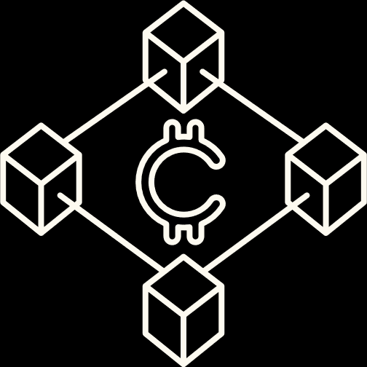
1.5 BLOCKCHAIN AND SMART CONTRACTS
A blockchain is essentially a distributed database of records or public ledger of all transactions or digital events that have been executed.
Smart contracts are digital contracts stored on a blockchain that are automatically executed when predetermined terms and conditions between the two parties are met.

Slide 9
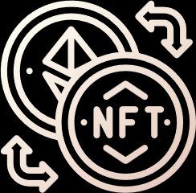
1.6 NON FUNGIBLE TOKENS
An NFT is a special type of digital asset or token that can be proved to be unique and not interchangeable with another digital asset token (i.e., fungible).
Uniqueness
Rarity
Ownership
Immutability
Programmability

Slide 10


2 . EXISTING SYSTEMS
Overview of Colored Coins[1]
CryptoKitties[2]
A mechanism to take advantage of Bitcoin’s fungibility” by segregating a certain number of coins from the rest.
It featured cartoon versions of cats and allowed players to “adopt”, “raise”, “breed” and virtually trade them.
Counterparty[3]
NFT Marketplace Based on Ethereum Blockchain[4]
It allowed for asset creation and had a decentralised exchange, as well as a native currency known as XCP.
It will enable the users to create new digital assets and trade them in exchange of Ethereum-based cryptocurrency.

Slide 11
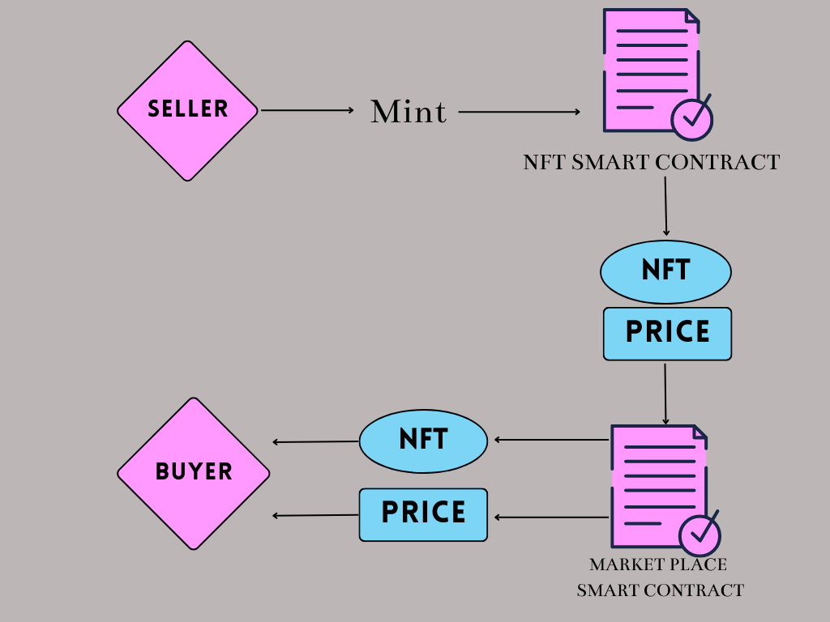
3. SYSTEM IMPLEMENTATION

Slide 12


USE CASE DIAGRAM
Makes Account on MetaMask
NFT SMART CONTRACT
Seller
Mint NFT
Price of NFT
Make Purchase of NFT
Buyer
MARKETPLACE
SMART CONTRACT

Slide 13
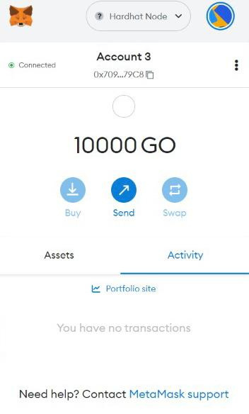
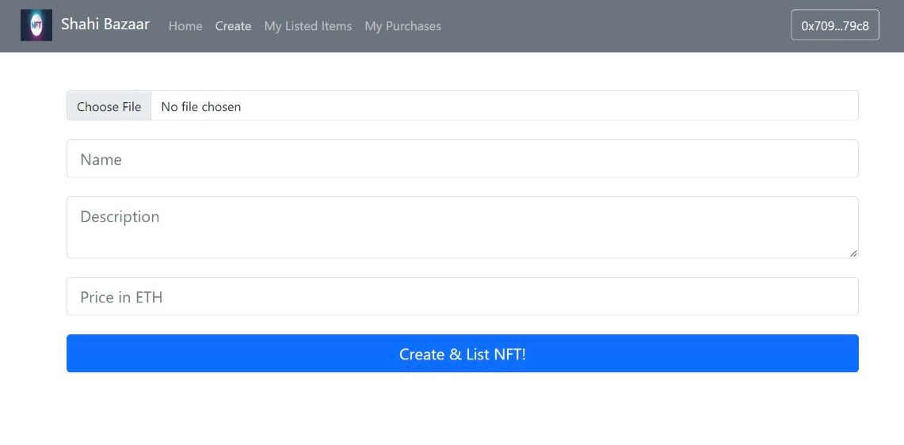
4 . SYSTEM ARCHITECTURE

Slide 14
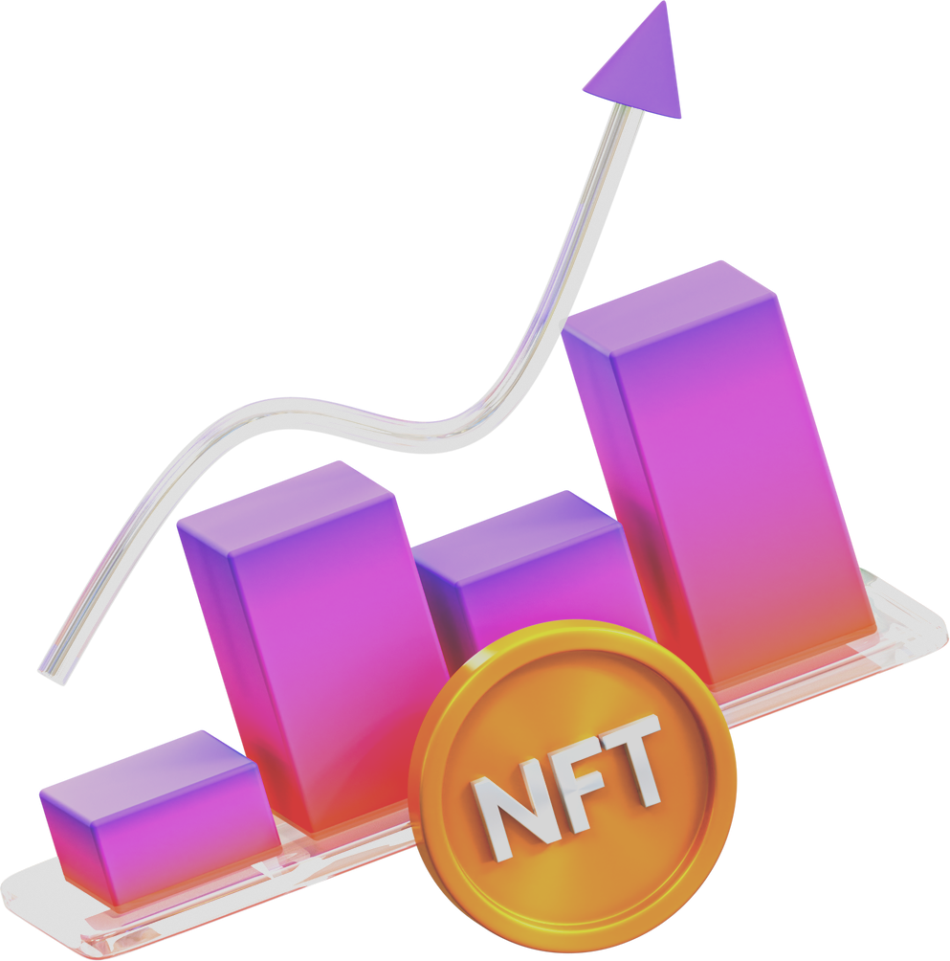
5 . CONCLUSION
The advantages of royalty sharing, versatile utilization, provenance, and exposure to larger markets.
The disadvantages are false belief of provenance, fraudulent behaviour, and legal aspects.

Slide 15
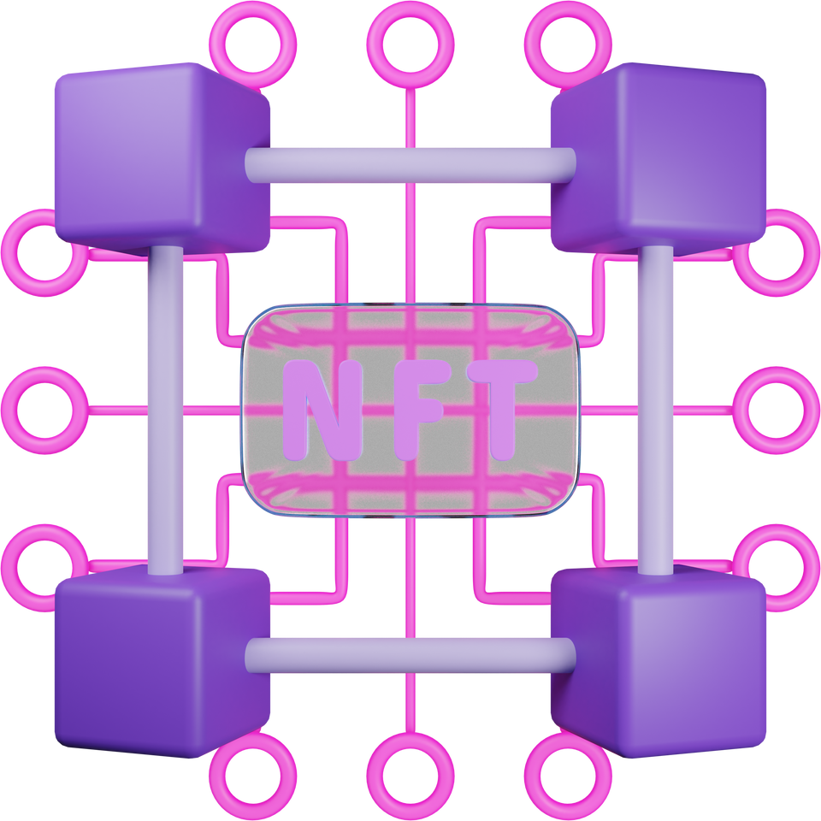
6 . REFERENCES
Hofmann, Adrian & Pytel, Norman & Winkelmann, Axel. (2020). Tracing Back the Value Stream with Colored Coins.
Gutte, Yogiraj & Vora, Aasit & Sharma, Yogesh & Bhardwaj, Bhaskar. (2022). NFT Marketplace Based on Ethereum Blockchain. International Journal of Advanced Research in Science, Communication and Technology. 179-186. 10.48175/IJARSCT-3729.
https://www.cryptokitties.co
https://counterparty.io

